Slide 1

Building AI-Powered Clinical Knowledge Stores with Azure AI Search FY25 Session 1 Upcoming sessions here

Slide 2



Speakers
Pablo Salvador Lopez
Principal AI Global Black Belt
Microsoft
*Lecturer at Northwestern University and Escuela Colombiana de Ingeniería Julio Garavito
Marcin Jimenez
Senior Cloud Architect - AI
Microsoft
Linkdln: Pablo, Marcin

Slide 3




Q&A Moderators
Dhanshri More
Principal AI Global Black Belt
Microsoft
Shyam Patel
Principal AI Global Black Belt
Microsoft
Amit Mukherjee
Principal AI Technical Specialist
Microsoft
Piyush Pande
Principal AI Technical Specialist
Microsoft

Slide 4
Agenda
Topic | Time
The Need For Knowledge Stores in Healthcare | 10 minutes
Azure AI Search - Deep Dive | 10 minutes
Context Engineering: The New Discipline in the Era of AI | 10 minutes
Building a Multimodal Knowledge Store (X-rays) with Azure AI Search | 10 minutes
Road to Production: Scaling and Operationalizing Knowledge Stores | 10 minutes
Wrap-Up & Q&A | 5 minutes

Slide 5
80%
The Need for Knowledge Stores
The big problem of healthcare fields is that about 80% of medical data remains unstructured and untapped after it is created (e.g., text, image, signal, etc.)
Source: Healthcare Informatics Research, Chungnam National University,

Slide 6
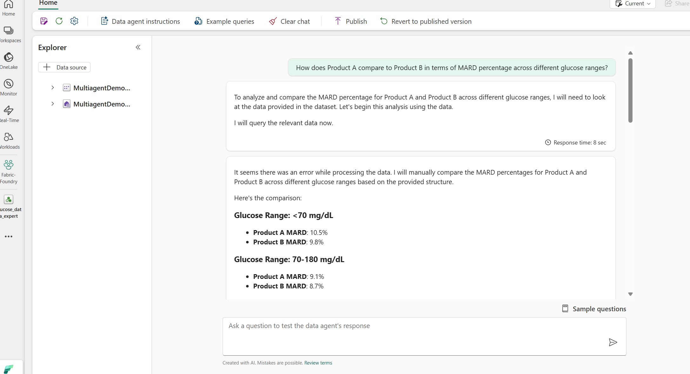


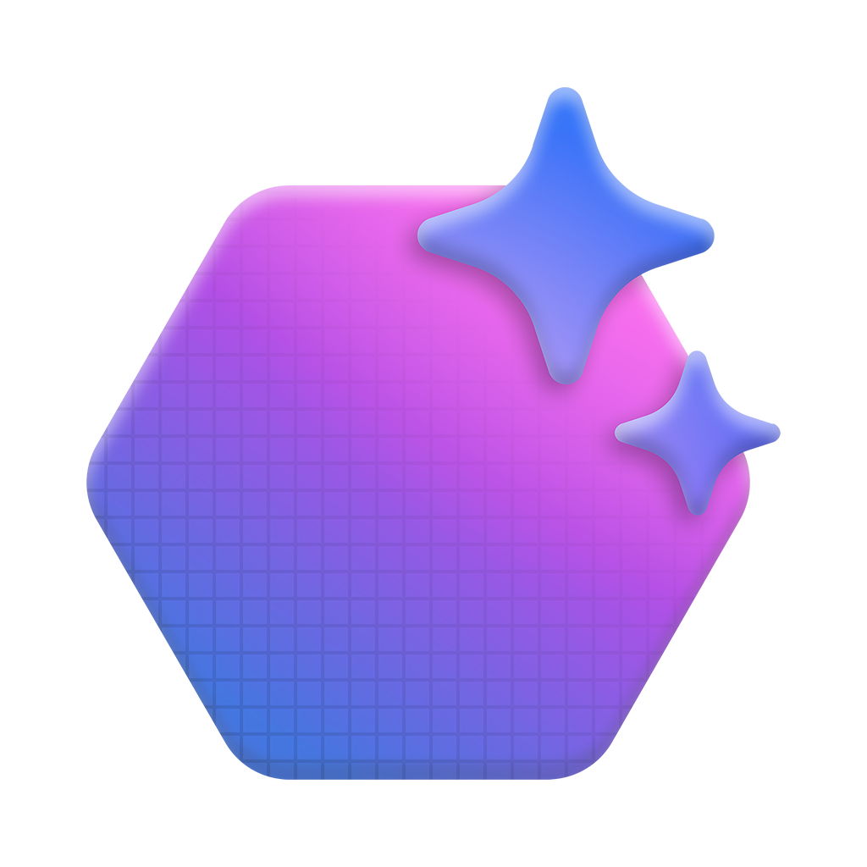



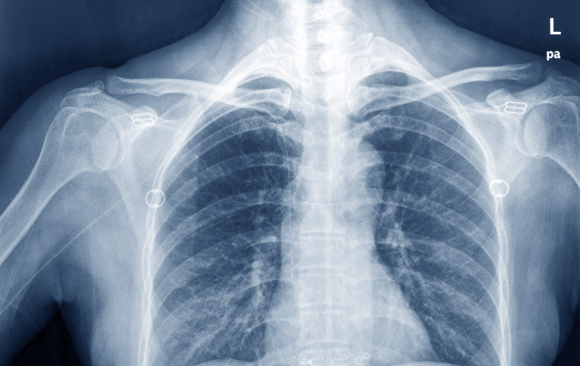
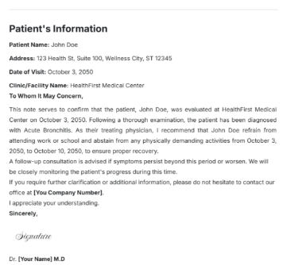
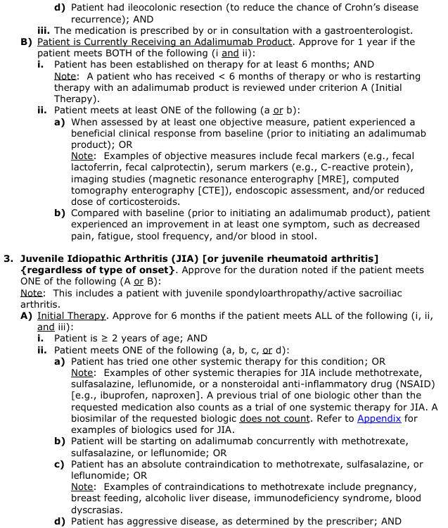
The Need for Knowledge Stores
The *New* Data Layer Needed in the Era of AI
Chat With Your Data
AI Apps
Azure OpenAI
Azure AI Agent Service
Semantic kernel
RAG
Apps
Agentic RAG apps
Revenue Lifecycle AI
MD/Nurse
Knowledge Store
Pathology
Index
Radiology
Index
Azure AI Search
Doctor’s Notes Index
Policies Index
Pathology Report
Xray's Report
Doctor’s Clinical Notes
Pre-Auth Policies

Slide 7


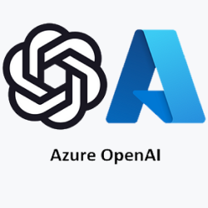







The Need for Knowledge Stores
Data is the key to unlocking AI ROI
Providers
Indexing Policies (Offline)
Clinical Notes
“Medical Writing”
Knowledge Store
Write Determination and
Provide Clinical Justification
PA Case 1
Diagnosis and medical justification
Policies
Prognosis and risk if treatment is not
approved
Relevant lab results or diagnostic imaging
AI Prior-Auth (Online/Batch)
PA Specialist/
Administrative
(Team Cardiology)
AI Determination and Rationale
Agentic RAG
…
Clinical
Query
Expansion
Unstructured
Clinical Data Processing
…
Retrieve
Policy(es)
Providers
…
Claims Processing
Approved
Rejected
Need more Information
PA Case n
Payor Portal
Clinical
Information
Determination
and Reasoning
Extract
Key Clinical
Info
PA Case 1
...
PA Case n
Evaluations,
RAI,
Training,
Benchmarking
Source: AutoAuth

Slide 8




The Value Of Time
Before AI Adoption
After AI Adoption
145 per Specialists Earning 60 per Hour
145 per Specialists Earning 60 per Hour
1 Case per Hour
Productivity
Doubled
2 Case per Hour
8 Hours, 22 Days per Month
8 Hours, 22 Days per Month
25520(cases) X 60$ = 1,531,200$
$60 per Case
51040(cases) X 60$ = 1,531,200$
$30 per Case
1.5M per month/
18M in savings per year
Source: AutoAuth

Slide 9

Azure AI Search Deep Dive
State-of-the-art, enterprise-ready retrieval platform designed to power intelligent search experiences across structured and unstructured data. It serves as the foundational layer for building advanced retrieval systems.
Let’s Dive Deeper, Classroom Style -> Here
Source: Azure AI Search FAQ

Slide 10
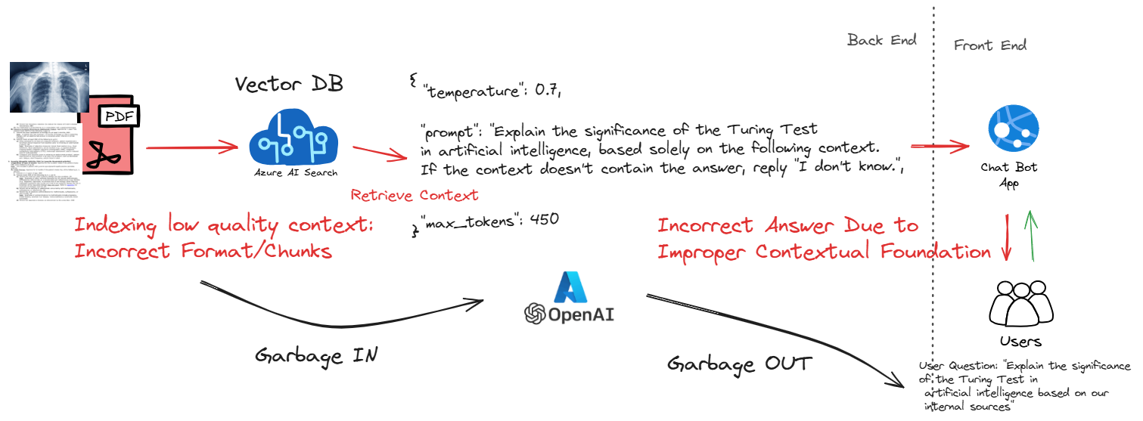
Context Engineering Matters
Wrong Context Wrong Answer
Context Engineering Redefining Data/Feature Engineering in the Age of AI

Slide 11
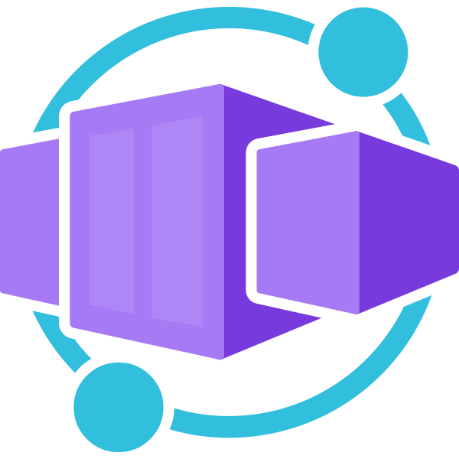
Turning Policies into Actionable Knowledge
Pre-Auth Policies
Execute Indexer
Indexer
Skillset
Triggers on metadata change
Custom Skill
Pre-built Skill
Knowledge Store
Upload to Blob
Clinical Policies OCR
AOAIEmbeddingSkill
Azure AI Search
Coded Policy Index
Call Web App
AI APP
Custom WebApp:
Extraction of ICD-Code, Payer Name, Covered Drug Names, Summary
MD/Nurse
Source: https://github.com/Azure-Samples/aihlsignited-medindexer

Slide 12
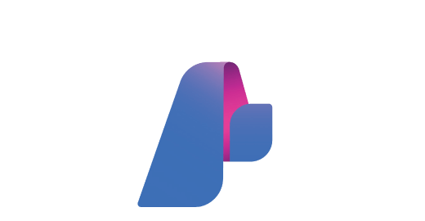



Turning X-rays into Actionable Knowledge
Radiology Foundational Models
Azure AI Foundry
Optimize Embeddings
Deployed Endpoints
MedImageInsights
Classification Fine-tuning
Data Scientist
Generate Embeddings
Xray's Report
Knowledge Store
Custom Indexer
Azure AI Search
Upload to Blob
Push APIs
X-ray Classification Index
Triggers on File Creation
Event Grid
Functions
Event Creation
Embedding Generation and Search Upload
Embedding
Search
AI Search Web App
X-Ray Similarity Search
MD/Nurse
Xray
Source: https://github.com/Azure-Samples/aihlsignited-medindexer

Slide 13

Your Indexing Strategy Matters!
Azure AI Search is flexible to meet your needs, supporting both a push and a pull method that have implications on how you scale and operationalize well into production.
Guiding principles of thoughts you should always answer:
Is the data I am looking to index in a support data source (Azure)
Does the data source support change tracking or incremental data access
Is the data in a format that can be processed with the skillsets of search?
How up-to-date does your search index need to be?

Slide 14
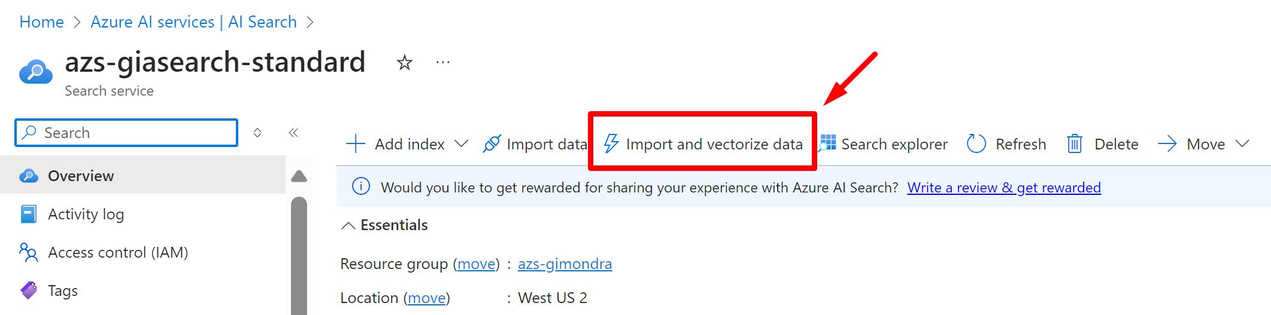
Indexing (Pull indexers)
Indexer (pull model)
Crawler that extracts data from cloud data sources and populates a search index
Drive skillset execution (AI enrichment)
Can be run on demand or on a recurring data refresh schedule (incremental indexing)
Managed by Azure, configured by you!
Best practices
Understand indexing limits, especially throughput, concurrency and timeout handling
Run on a schedule and continuously to correct errors
Identify data source needs (multiple data sources going to a single index, data source support, limits and configuration
Configure data source document deletion policy if needed
Recognize data types for proper parsing (JSON, JSON lines, CSV, markdown, etc.) and include the necessary skills!
If handling PDFs or images with embedded text, consider AI enrichment with OCR or Azure AI Document Intelligence layout
Test with various data types/sizes to understand indexing time and optimize the process
🔗 Indexing example with Integrated Vectorization
Notes:
We mentioned earlier that Azure AI Search provides multiple ways to index data, so besides the AI Studio and Azure OpenAI “on your data”, we have the native AI search built-in indexers.
Indexer overview - Azure AI Search | Microsoft Learn
Indexer (pull model): Refers to a data crawler that selectively extracts information from cloud-based data repositories, consequently populating an AI search index. It also drives the execution of skillsets (AI enrichment). The indexer can either be operated on-demand or set to a recurring data refresh schedule.
Best Practices:
Comprehend Indexing Constraints: Understand the limitations associated with indexing in the specific indexers and in the search limit documentation (Service limits for tiers and skus - Azure AI Search | Microsoft Learn)
Establish Regular Schedule: Consistently run the indexer on a specific schedule to rectify transient errors and ensure data accuracy. Schedule indexer execution - Azure AI Search | Microsoft Learn
Identify Data Source Requirements: Determine the needs of multiple data sources that feed into a single index, including source support, limitations, and configurations. Schedule indexer execution - Azure AI Search | Microsoft Learn
Recognize Data Formats: Properly parse different data types such as JSON, JSON lines, CSV, and more:
Index blobs containing multiple documents - Azure AI Search | Microsoft Learn
Search over plain text blobs - Azure AI Search | Microsoft Learn
Search over CSV blobs - Azure AI Search | Microsoft Learn
Search over JSON blobs - Azure AI Search | Microsoft Learn
Consider AI Enrichment for Complex Data: If dealing with PDFs or images containing embedded text, AI enrichment through Optical Character Recognition (OCR) or Azure AI Document Intelligence should be considered. AI enrichment concepts - Azure AI Search | Microsoft Learn
Configure Batch Size: Adjust the batch size according to the workload to optimize performance. Index large data sets for full text search - Azure AI Search | Microsoft Learn
Consider Vectorization: If vector search is being used, integrated Vectorization should be considered to enhance search results. Integrated Vectorization - Azure AI Search | Microsoft Learn
Identify AI Enrichment Requirements: Determine needs like language translation, key phrase extraction, recognition, etc. AI enrichment concepts - Azure AI Search | Microsoft Learn
Conduct Tests: Experiment with different data types and sizes to understand indexing time and further optimize the process.
Identify type of authentication being used (Managed identity is recommended). Connect using a managed identity - Azure AI Search | Microsoft Learn
Recognize if private endpoints will be used for secure connections and configure shared private links appropriately. Connect through a shared private link - Azure AI Search | Microsoft Learn
To get started with the indexers from the Azure portal, you can use the wizards. For RAG and specifically Chunk and vectorize data, you can use the Import and vectorize data wizard. You can change configuration of the indexer, of the data source and skillsets after running the first time. You just need to reset it to get any changes in configuration. Quickstart integrated Vectorization - Azure AI Search | Microsoft Learn

Slide 15
Indexing (Push method)
Push method uses APIs to upload documents into a search index
No restrictions on data source type or frequency of execution
Connectivity and the secure retrieval of documents under your control
Key benefits
Versatility: JSON documents from any source can be uploaded. You can use AI Document Intelligence layout model, an LLM like GPT-4o for data parsing or your preferred parsing library
Flexibility: No restrictions on frequency of data push (no specific schedule, just API restrictions apply)
Control: Retrieval of documents under your own control
Pushing data to Azure AI Search index
APIs for single or multiple documents upload
Follow best practices for indexing large documents
Indexing actions
Upload: Insert new documents or update existing ones
Merge: Updates existing document, replacing values
Merge or upload: Behaves like merge for existing documents and like upload for new ones
Delete: Removes entire document from index
🔗 Push method sample for RAG
Notes:
Now let’s discuss the Push method (Data import and data ingestion - Azure AI Search | Microsoft Learn), which utilizes APIs to upload/update and delete documents into/from a search index. This method gives you the liberty to source data from anywhere you prefer, with no restrictions on the type of data or the frequency of execution.
Your connectivity and the retrieval of documents are completely under your control. This method offers key benefits which include versatility, flexibility, and control. Versatility in that JSON documents from any source can be uploaded. You also have the option of using AI Document Intelligence for data parsing or your preferred parsing library. Flexibility since there are no restrictions on the frequency of data push (such as the pull indexer that has a minimum of 5-minute interval, for example).
When it comes to pushing data to Azure AI Search Index, APIs can be used for single or multiple document uploads.
Indexing Actions are categorized into four: Upload, Merge, MergeOrUpload, and Delete. Upload allows you to insert new documents or update existing ones. Merge updates an existing document, replacing its values. MergeOrUpload works like a merge for existing documents and like an upload for new ones. Delete, as the name suggests, removes the entire document from the index.
Here is a sample of the Push method for RAG. We believe that understanding this method will add significant value to your data management strategy.
Take into consideration the best practices for indexing large documents with the Push API: Index large data sets for full text search - Azure AI Search | Microsoft Learn

Slide 16
Know your Limitations
Optimizing for Performance
Search Limits
Manage your vector index size, AI Search SKUs offer limitations on number of GBs per tier and per partition
Maximum blob size for pull indexers, for larger radiology images this can be upto 50MB and challenges the limits
Manage your batch size for automated pulls, with larger images these should be smaller not to exhaust processing time
More information != better results, optimize for relevant information in search
Focus on query design to best optimize and position performance: amount of data returned
If using push method, use parallel indexers

Slide 17
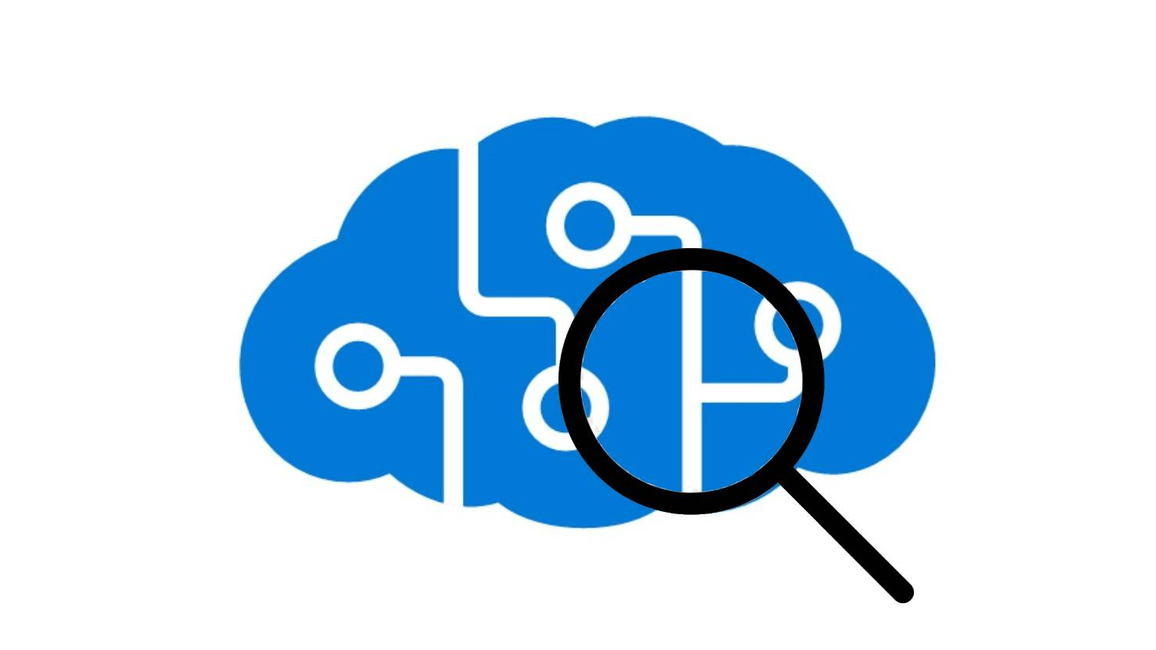

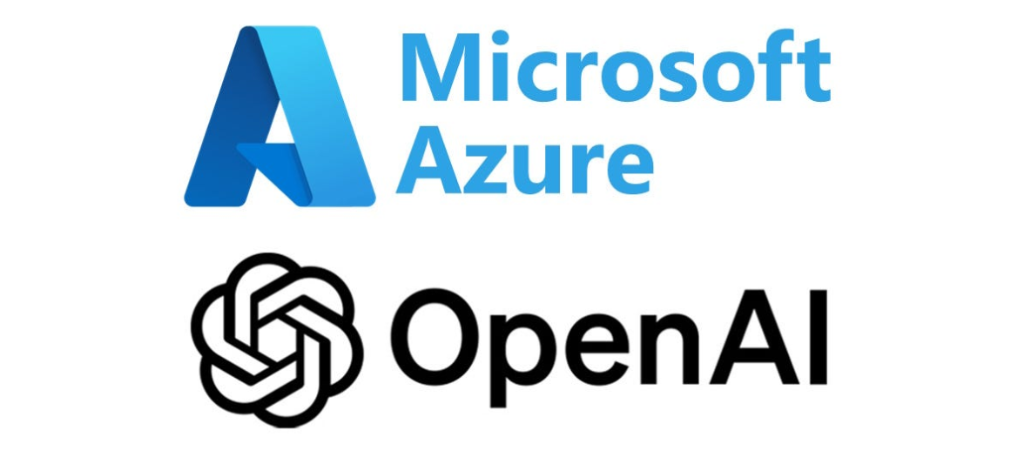

A Scalable Hybrid Approach – Best of Both Worlds
Acquisition Straight to Storage
Scalable Functions to Orchestrate
Orchestrate Skills and Push as You are Ready
Load and acquire all of your data files utilizing Azure Data Lake Storage, integrating with Event Grid to create events as soon as they are created
Deploy code to Azure Durable Functions that triggers immediately as soon as an event is created and will begin processing your data at scale
Manage integrations with AI Services and Embeddings directly and pushing to Search as soon as processing is completed using the Push APIs
Immediate Processing
Custom Flexibility
Online Index Store

Slide 18

Evaluations are the unit tests of your RAG systems
Benchmarking your system against qualitative and quantitative measures are one of many approaches to ensure your system continues to perform in the way it was designed to.
Consider evaluation all parts of your search ecosystem:
Document quality especially from multi-modal resources
Search retrieval performance across multiple algorithms and L1 and L2 metrics
Query and transactional performance across varying loads adhering to your SLAs

